Slide 1
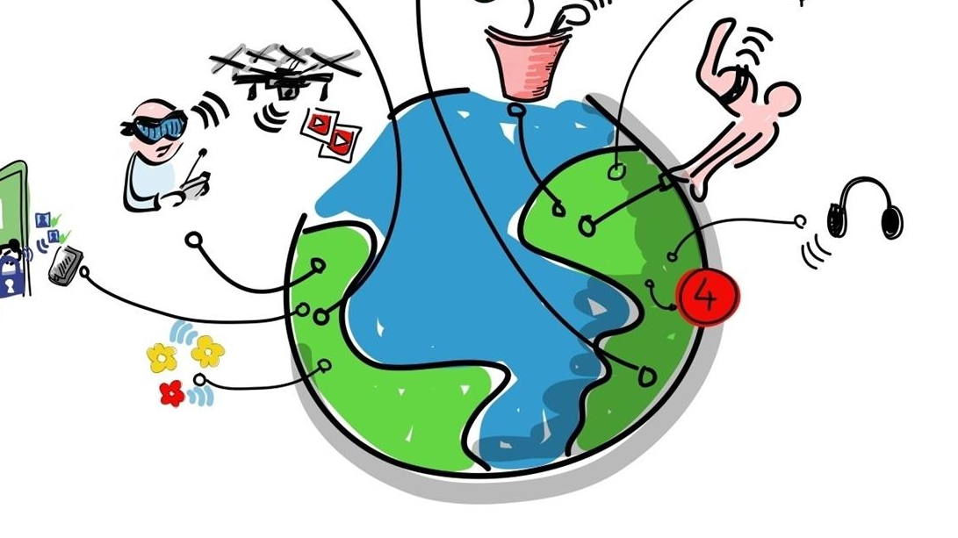
Internet of Things
HOW to monitor temperature
by using kafka, hive and jupyter
Nha Doan
Nhat Pham

Slide 2
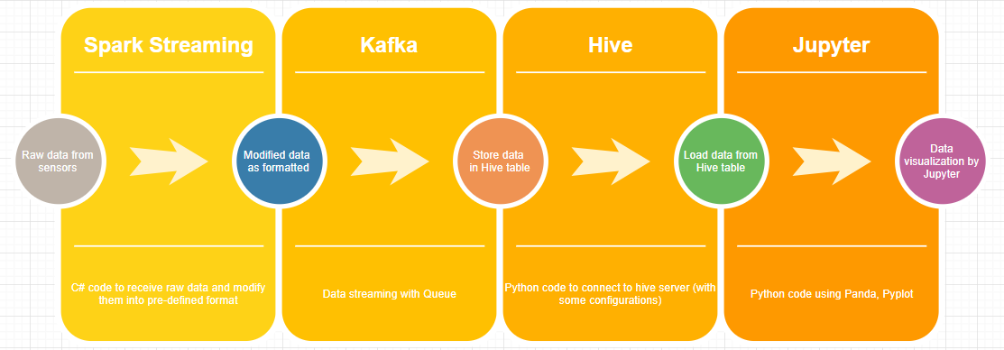
System overview
From 2 temperatur sensors.
Some funny facts:
.
.
Notes:
Consider talking about:
Consumer application
Enterprise
Infrastructure Management
Other fields of application

Slide 3
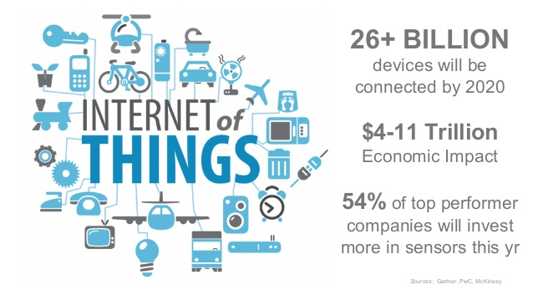
Spark Streaming
From 2 temperature sensors.
Some funny facts:
.
.
Notes:
Consider talking about:
Consumer application
Enterprise
Infrastructure Management
Other fields of application

Slide 4
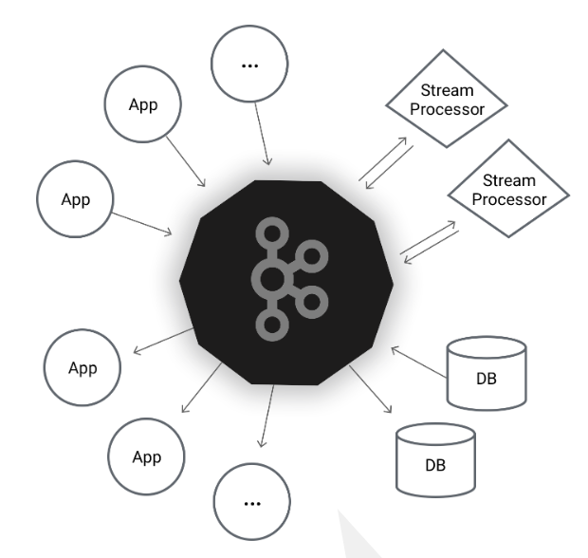
Apache Kafka
.
.
Notes:
Consider talking about:
Consumer application
Enterprise
Infrastructure Management
Other fields of application

Slide 5

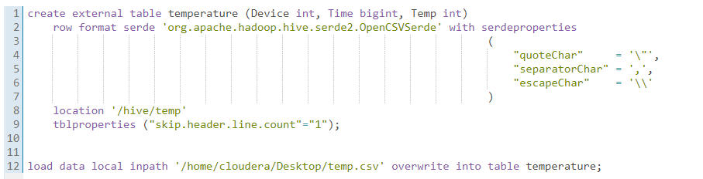
APACHE HIVE – HQL
Why?
Familiar, fast, scalable, and extensible.
How to config?
Code:
Notes:
Consider talking about:
Consumer application
Enterprise
Infrastructure Management
Other fields of application

Slide 6

Jupyter – data visualization
Why?
open-source software
open-standards
services for interactive computing across 40 programming languages, including Python, R, Julia, and Scala
How to config?
Installing Jupyter using Anaconda
On Cloudera Quickstart: pyspark
Installing Jupyter with python pip
Notes:
Consider talking about:
Consumer application
Enterprise
Infrastructure Management
Other fields of application

Slide 7
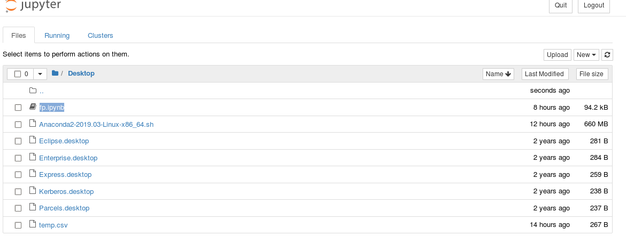
Jupyter – data visualization
Notes:
Consider talking about:
Consumer application
Enterprise
Infrastructure Management
Other fields of application

Slide 8
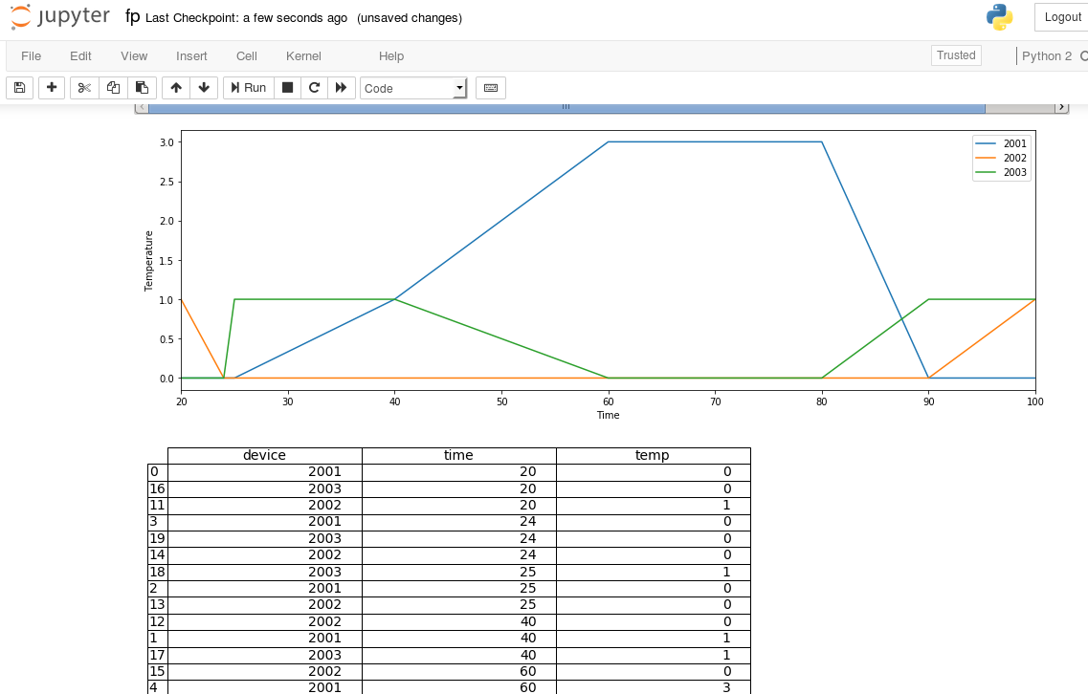
Jupyter – data visualization
Notes:
Consider talking about:
Consumer application
Enterprise
Infrastructure Management
Other fields of application

Slide 9
REFERENCES
Cloudera Quickstart VM: https://www.cloudera.com/downloads.html??utm_campaign=Download_sitelink&src=GoogleAdWords&gclid=Cj0KCQjwoInnBRDDARIsANBVyATE8Hl5CCfMLGunWSU0NzXXgagfl1g13jJMRslhZrtTaTNZuqY0DZwaAmeREALw_wcB
Cloudera - Ports Used by Components: https://www.cloudera.com/documentation/enterprise/5-2-x/topics/cdh_ig_ports_cdh5.html
Hive: https://hive.apache.org/index.html
Jupyter: https://jupyter.readthedocs.io/en/latest/index.html
Kafka: https://kafka.apache.org/
Matplotlib.pyplot – a MATLAB-like plotting framework: https://matplotlib.org/api/pyplot_api.html
Pandas – a Python Data Analysis Library: https://pandas.pydata.org/

